Slide 1



Used Car Price Prediction
By:
Paras Malhotra

Slide 2
ACKNOWLEDGMENT
I express my sincere gratitude to Flip Robo Technologies for giving me the opportunity to work on this project on Used Car Price Prediction using machine learning algorithms. I acknowledge my indebtedness to the authors of online articles titled: “Factors which affect used car valuation price” and “Just What Factors Into The Value Of Your Used Car?” for providing me with invaluable insights and knowledge of the various factors that determine the price of a used car.

Slide 3
INTRODUCTION
Business Problem Framing
With the covid 19 impact in the market, there have been lot of changes in the car market. Now some cars are in demand hence making them costly and some are not in demand hence cheaper. With the change in market due to covid 19 impact, our client there is a need for new machine learning models from new data. Therefore, new car price valuation model is required to be made.
Conceptual Background of the Domain Problem
Predictive modelling, Regression algorithms are some of the machine learning techniques used for predicting Used Car prices. Identifying various relevant features of a car, its present condition, ownership and total usage by previous owner(s) are crucial for working on the project as they determine its valuation.

Slide 4
INTRODUCTION
Review of Literature
3 Online Articles, namely: “Factors which affect used car valuation price” and “Just What Factors Into The Value Of Your Used Car?” were reviewed and studied to gain insights into all the attributes that contribute to the price of a used car.
It is learnt that Economic Factors, Vehicle Make, Vehicle Class and Body Style, Mileage, Transmission Type and technology are some the most important factors that determine a used car’s valuation.
https://www.moneycrashers.com/factors-affect-used-cars-resale-value/
https://www.investopedia.com/articles/investing/090314/just-what-factors-value-your-used-car.asp
https://autoportal.com/articles/factors-which-affect-used-car-valuation-price-6446.html

Slide 5
INTRODUCTION
Motivation for the Problem Undertaken
With the covid 19 impact in the market, we have seen lot of changes in the car market. Now there is a boom in demand for cars in the market, hence making them costly, while some are not in demand hence cheaper. There is a need for building machine learning models from new data that would help accurately predict the valuation of used cars based on various attributes.

Slide 6
Analytical Problem Framing
Mathematical/ Analytical Modelling of the Problem
Various Regression analysis techniques were used to build predictive models to understand the relationships that exist between used car price and features and attributes of the car. The Regression analysis models were used to predict the car price value for changes in car attributes. Regression modelling techniques were used in this Problem since Car Price data distribution is continuous in nature.
In order to forecast car price, predictive models such as ridge regression Model, Random Forest Regression model, Decision tree Regression Model, Support Vector Machine Regression model, Extreme Gradient Boost Regression and K Nearest Neighbours model were used to describe how the values of Car Price depended on the independent variables of various Car attributes.

Slide 7
Analytical Problem Framing
Data Sources and their formats
The Dataset was compiled by scraping Data for various Car attributes and Price from https://droom.in/.
The data was converted into a Pandas Dataframe under various Feature and Label columns and saved as a .csv file.

Slide 8
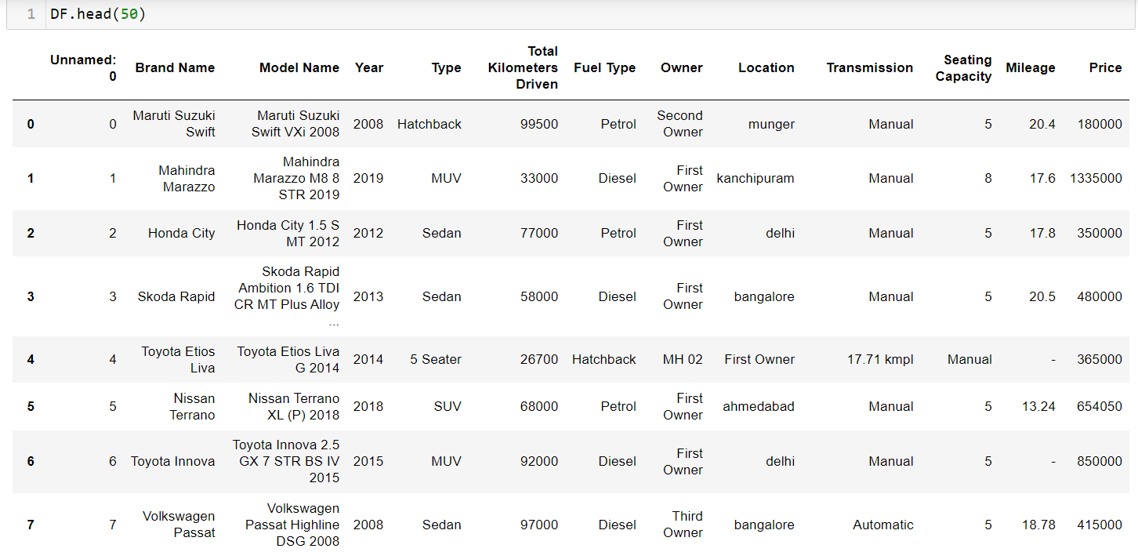

Slide 9
Dataset Description
The Independent Feature columns are:
Brand Name: Name of the Car Brand
Model Name: Name of the specific Car Model of a Brand
Year: Year of Manufacture
Type: Car Model Type
Total Kilometers Driven: Total Kilometers,for which the car has been so far driven.
Fuel Type: Type of fuel used
Owner: The ordinal number of previous owner

Slide 10
Location: Availability Location of Car
Transmission: Power Transmission type of the car
Seating Capacity: Total number of passengers that the car can accomodate
Mileage: Mileage of the Car
Target / Label Column:
Price: Selling Price of the Car

Slide 11
Data Preprocessing Done
Rows containing incorrectly entered data were removed first.
Data in columns: Seating Capacity,Mileage,Price,Total Kilometers Driven,Year were converted to int64 / float data type.
There were rows containing a character: ‘-‘ as data. These entries were first converted into NaN values and then imputed with data using most frequently occurring value imputation and KNN imputation techniques.
Duplicate data elements which had their starting letters in upper case and lower case were converted to data elements starting with uppercase letters.
Columns: Unnamed: 0(just a series of numbers) was dropped since it doesn't contribute to building a good model for predicting the target variable values.

Slide 12
Feature Engineering:
In order to better understand the relationships between Car price and Car attributes, ‘Brand’,’Model’ and ‘Variant’ columns were created based on data of existing columns: ‘Brand Name’ and ‘Model Name'.
Column ‘Car Age’ was created based on data from ‘Year’.

Slide 13
Data Inputs- Logic- Output Relationships
The Datasets consist mainly of Float and Object data type variables. The relationships between the independent variables and dependent variable were analysed.

Slide 14
Hardware and Software Requirements and Tools Used
Hardware Used:
Processor: AMD Ryzen 9 5900HX(8 Cores 16 Logical Processors)
Physical Memory: 16.0GB (3200MHz)
GPU: Nvidia RTX 3060 (192 bits), 6GB DDR6 VRAM, 3840 CUDA cores.

Slide 15
Software Used:
Windows 10 Operating System
Anaconda Package and Environment Manager: Anaconda is a distribution of the Python and R programming languages for scientific computing, that aims to simplify package management and deployment. The distribution includes data-science packages suitable for Windows and provides a host of tools and environment for conducting Data Analytical and Scientific works. Anaconda provides all the necessary Python packages and libraries for Machine learning projects.

Slide 16
Jupyter Notebook: The Jupyter Notebook is an open-source web application that allows data scientists to create and share documents that integrate live code, equations, computational output, visualizations, and other multimedia resources, along with explanatory text in a single document.
Python3: It is open source, interpreted, high level language and provides great approach for object-oriented programming. It is one of the best languages used for Data Analytics And Data science projects/application. Python provides numerous libraries to deal with mathematics, statistics and scientific function.

Slide 17
Python Libraries used:
Pandas: For carrying out Data Analysis, Data Manipulation, Data Cleaning etc
Numpy: For performing a variety of operations on the datasets.
matplotlib.pyplot, Seaborn: For visualizing Data and various relationships between Feature and Label Columns
Scipy: For performing operations on the datasets
Statsmodels: For performing statistical analysis

Slide 18
sklearn for Modelling Machine learning algorithms, Data Encoding, Evaluation metrics, Data Transformation,Data Scaling, Component analysis,Feature selection etc.
Exploratory Data Analysis
Visualizations
Barplots,Distplots,Boxplots,Countplots,lineplots were used to
visualise the data of all the columns and their relationships
with Target variable.

Slide 19
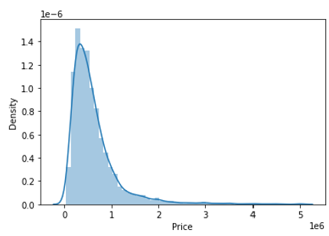
Univariate Analysis
Analyzing the Target Class
From the graph above it is observed that the Price data forms a continuous distribution and the distribution is skewed.

Slide 20
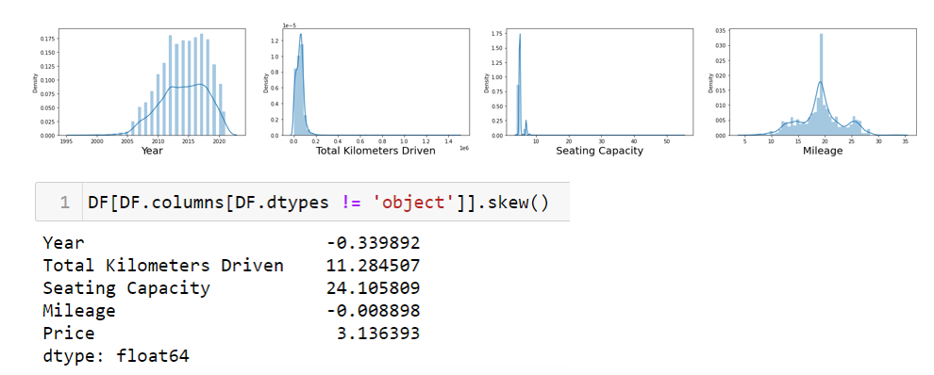
Analyzing the Feature Columns
Year and Mileage columns look normally distributed, while Total kilometers Driven and Seating Capacity are skewed

Slide 21
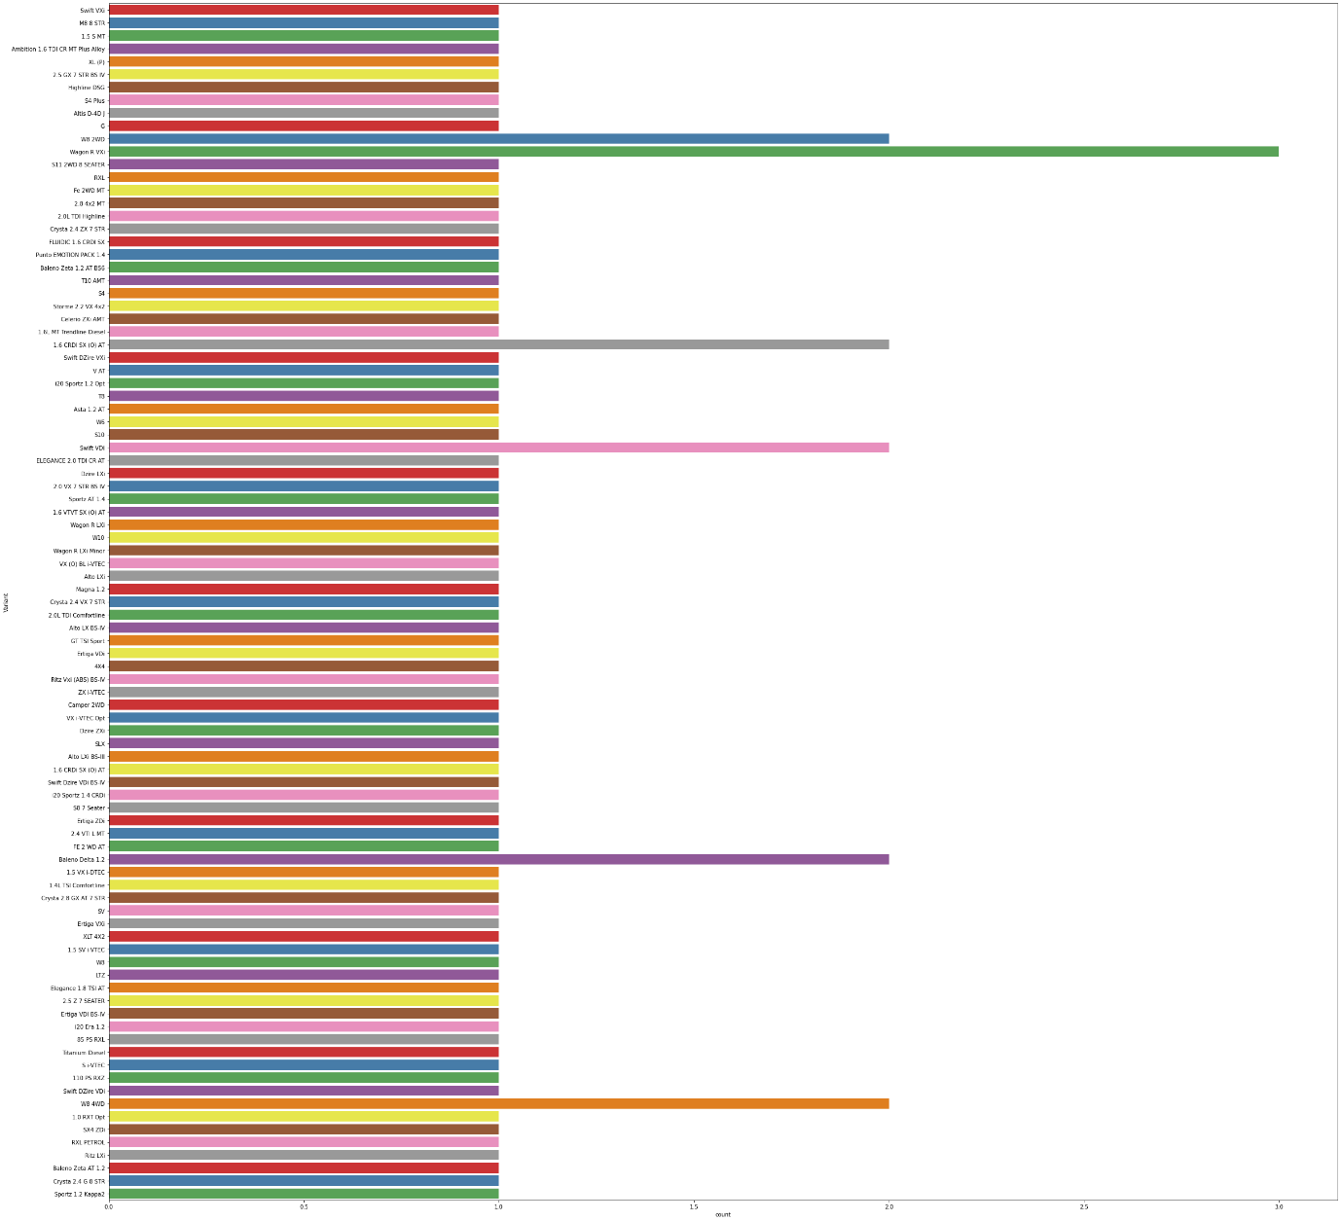

Slide 22
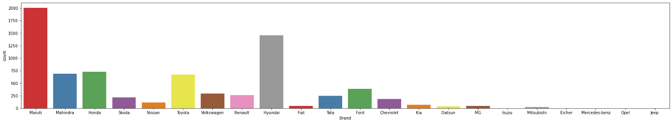
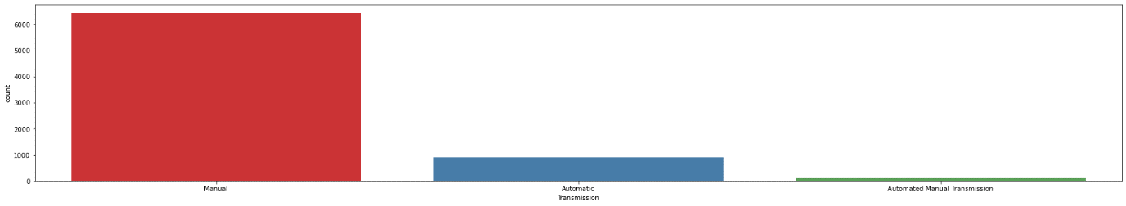
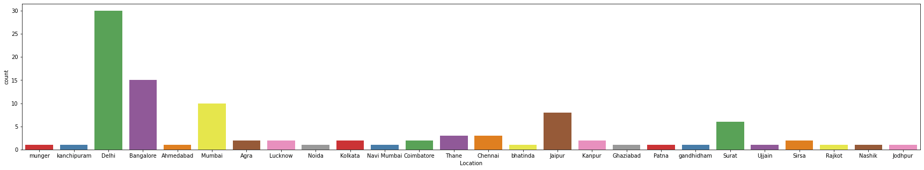

Slide 23
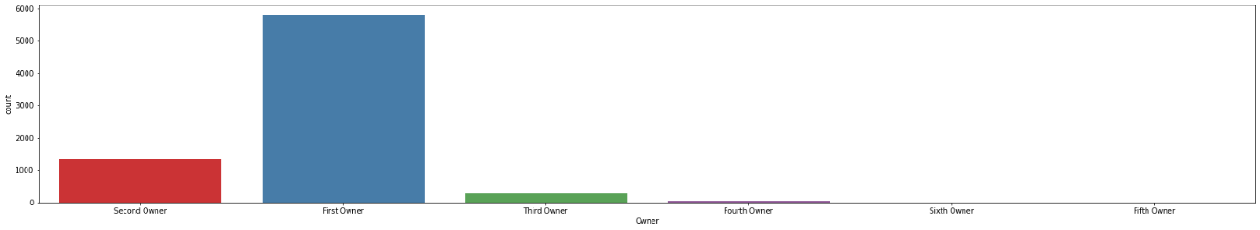
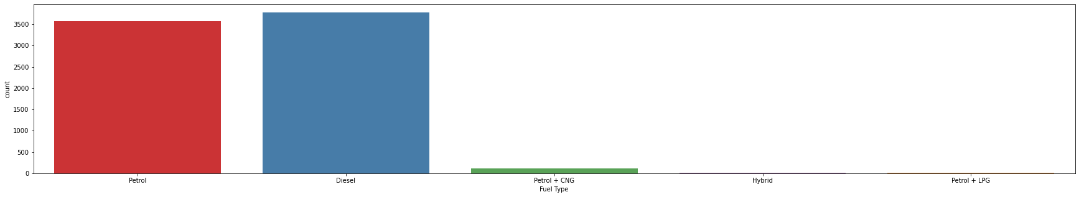
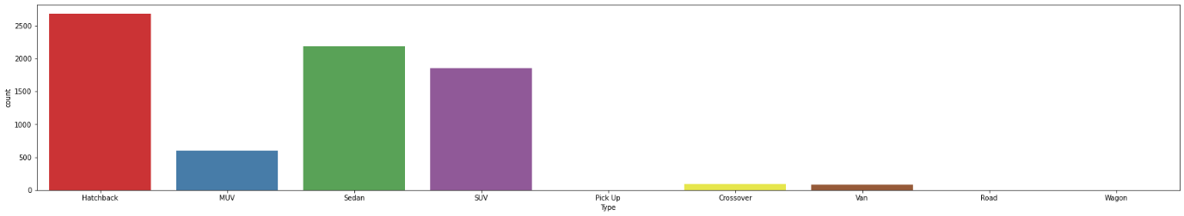

Slide 24
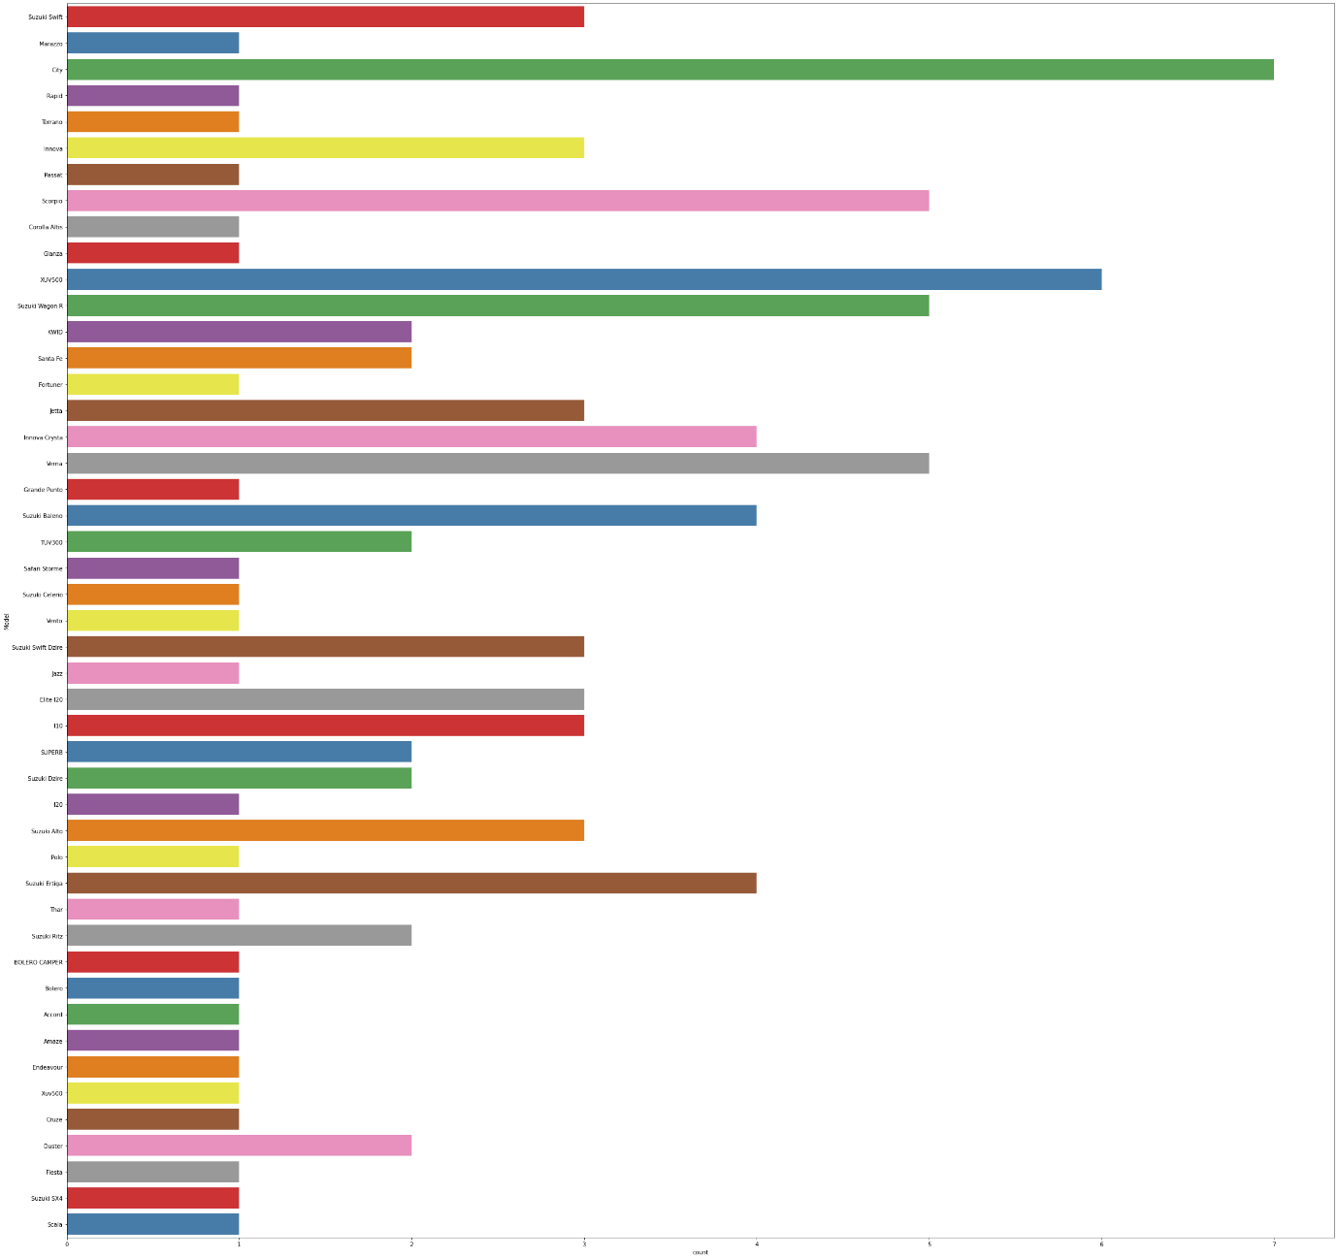

Slide 25
From the above graphs it is observed that:
Swift VDi,Swift DZire VDi,Swift VXi,Wagon R LXi,Alto LXi are the most common used cars on sale
Maruti and Hyundai are the most common brands of used cars
Manual Transmission is the most common amongst cars
Most used cars on sale are located in Delhi and Bangalore
Most used cars on sale have only had 1 owner before
Petrol and Diesel are the most common fuel types
Hatchback,Sedan and SUV are the most common Car types available

Slide 26
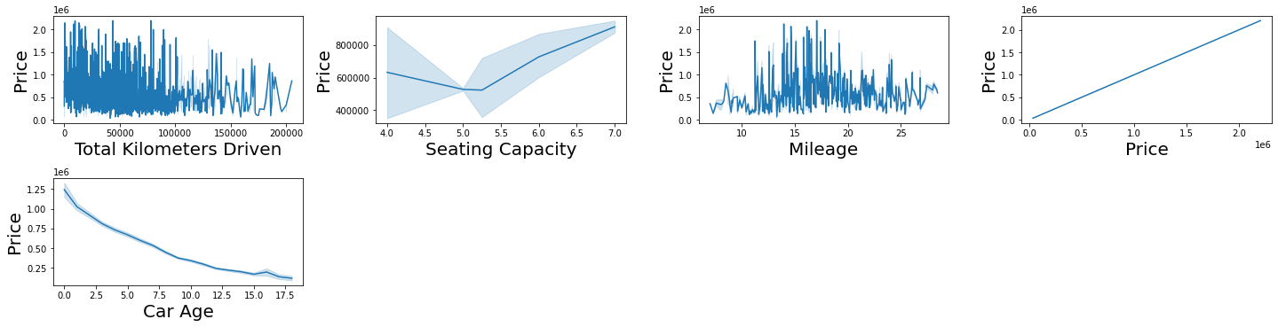
Bivariate Analysis
Interpreting Relationship between Dependent Variable and Independent Variable Columns

Slide 27
Following Observations are made from graphs above:
There is a negative correlation between Total Kilometers Driven and Price
Cars with Mileage between 14 km/l and 19 km/l have the highest prices
There is a negative correlation between Car Age and Price
There is a positive correlation between Seating capacity and Price

Slide 28
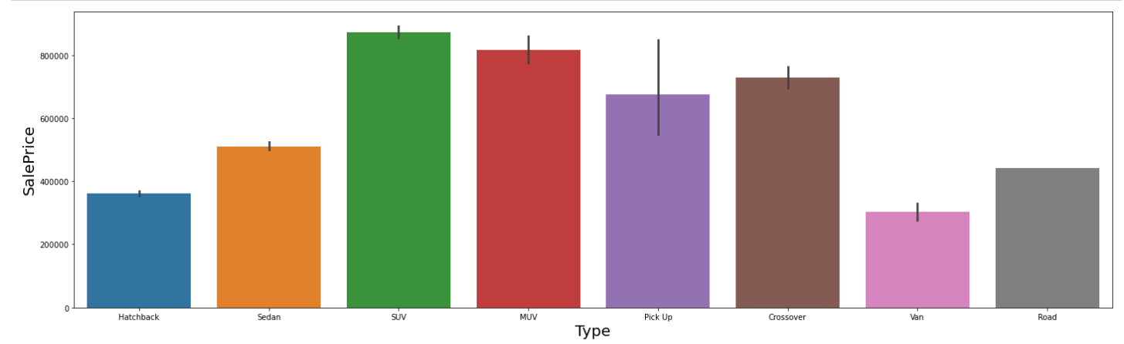
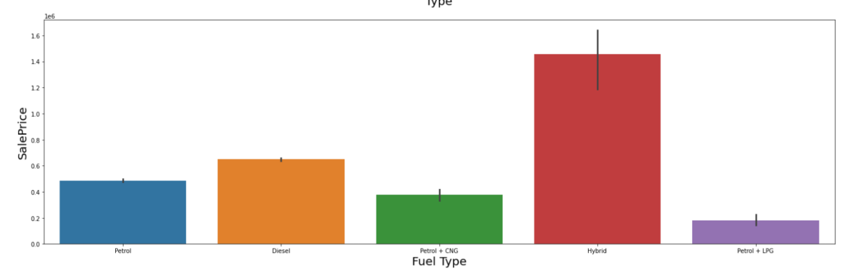
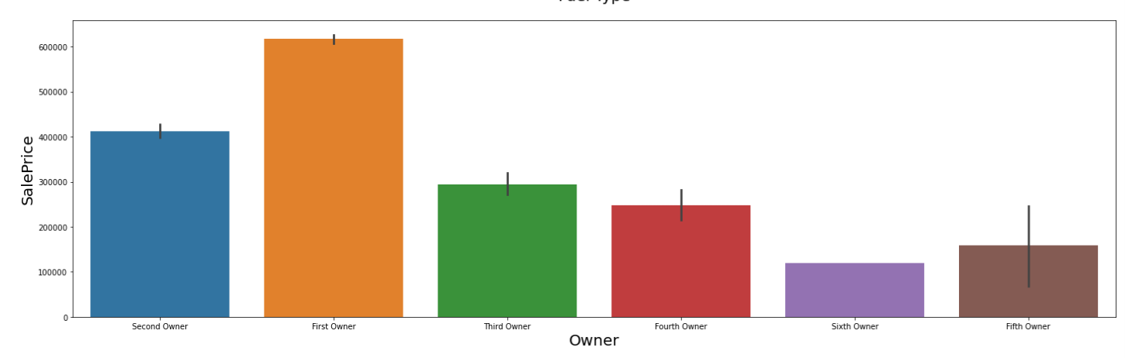

Slide 29
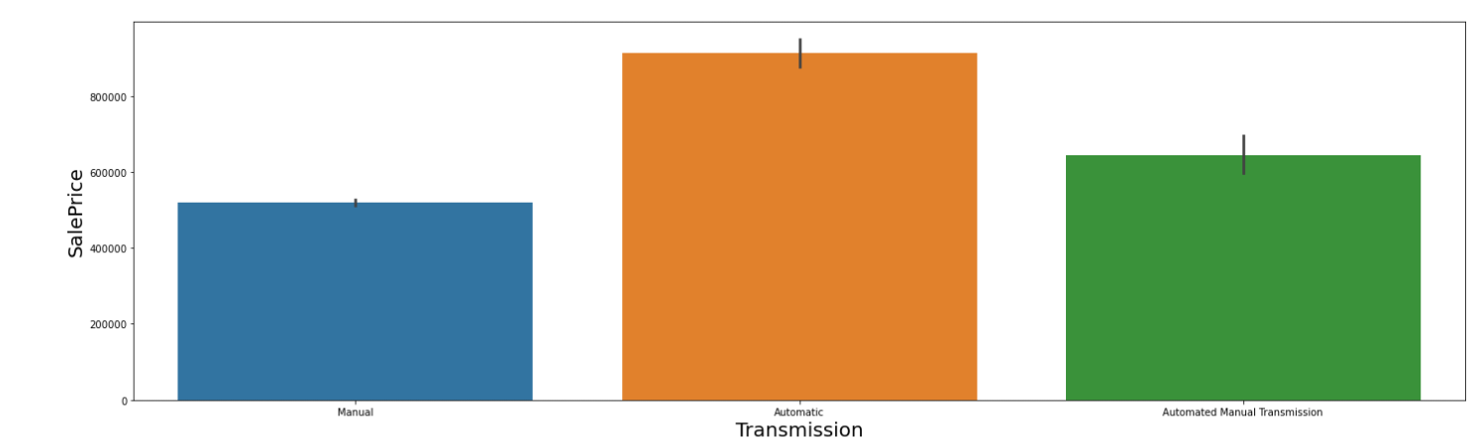
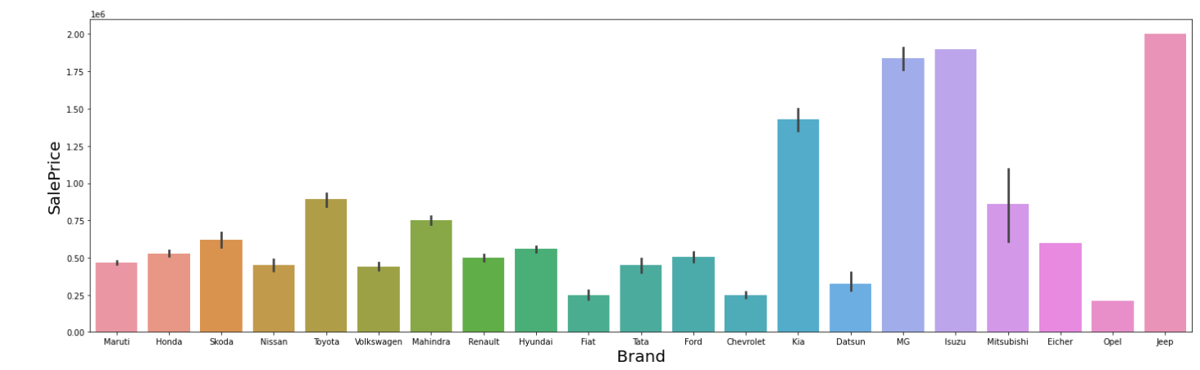

Slide 30
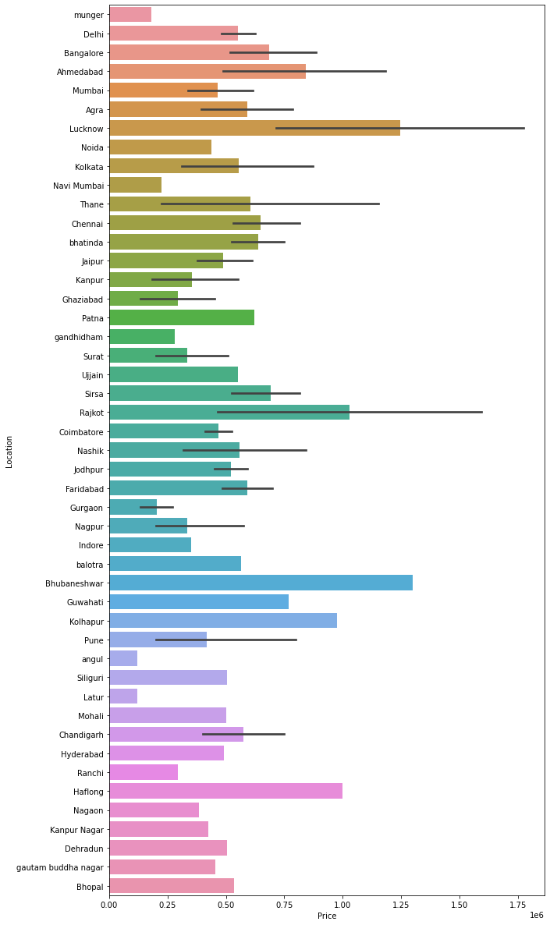

Slide 31
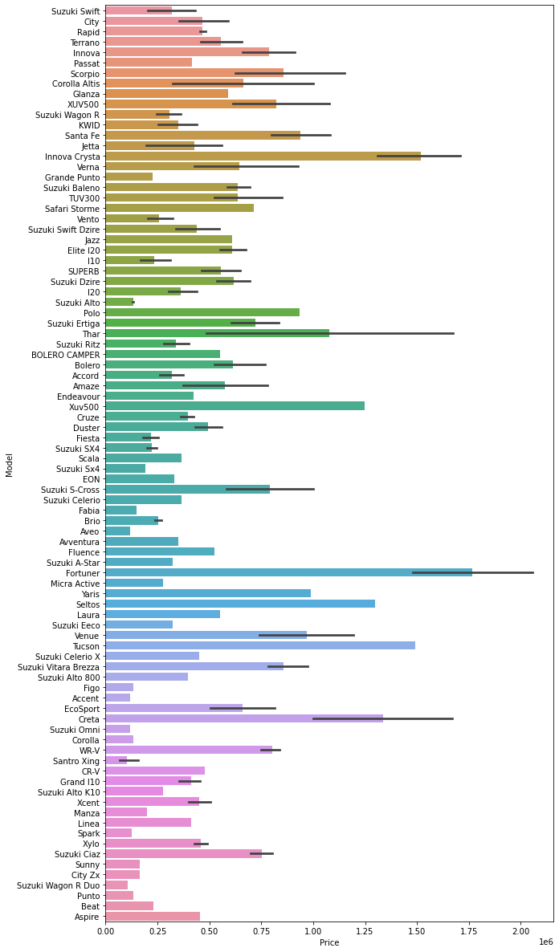

Slide 32
Following Observations are made from graphs above:
SUV,MUV,Pickup and Crossover type Cars have the highest Prices
Hybrid Fuel Type Cars are the costliest
As the Number of previous owners increases, the price of used car decreases, so there is a negative correlation between ownership and Car Price
Automatic Cars have the highest prices
Kia,MG,Isuzu and Jeep are amongst the most expensive Car Brands while Maruti,Volkswagen,Chevrolet,Opel,Tata,Honda,Fiat and Ford are the most affordable Car Brands
Car Prices are highest in Lucknow,Rajkot,Bhubhaneshwar,Kohlapur,Ahmedabad and Haflong
Creta,Fortuner,Tucson,Seltos,Xuv500,Thar,Innova Crysta are amongst the most expensive car models, while Beat,Punto,Wagon R,Santro Xing,Alto,Fiesta are amongst the most affordable

Slide 33
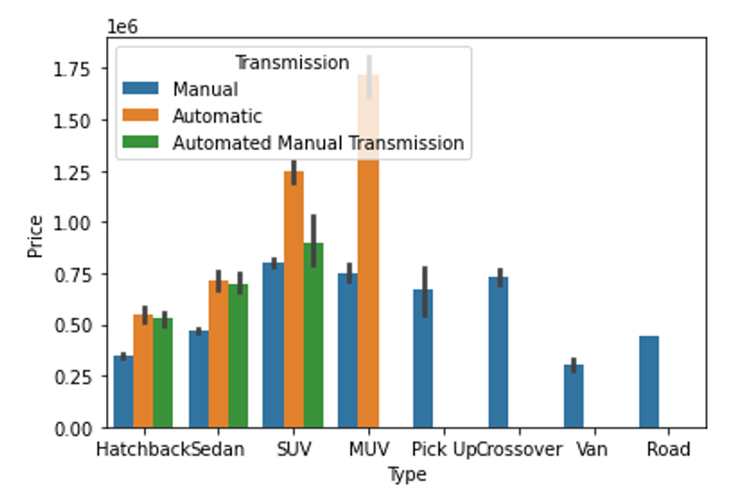
Multivariate Analysis

Slide 34
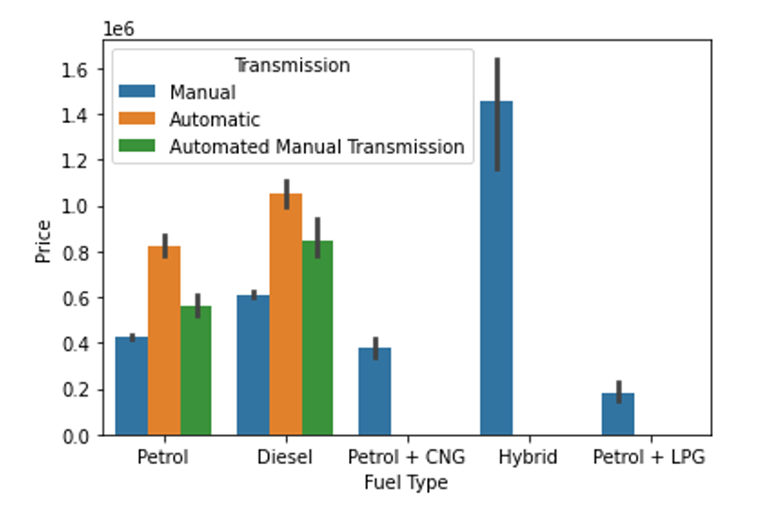

Slide 35
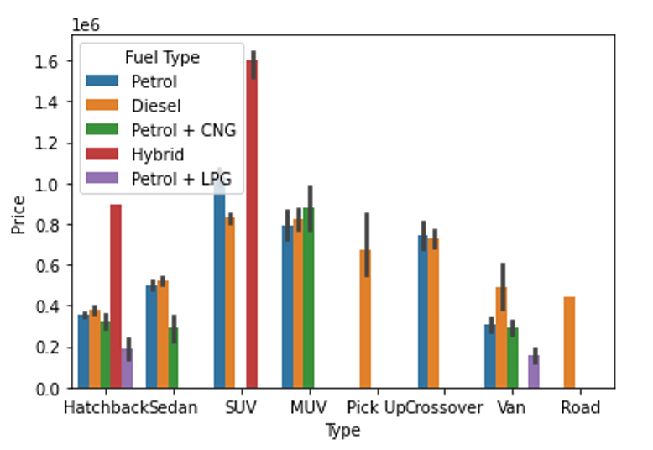

Slide 36
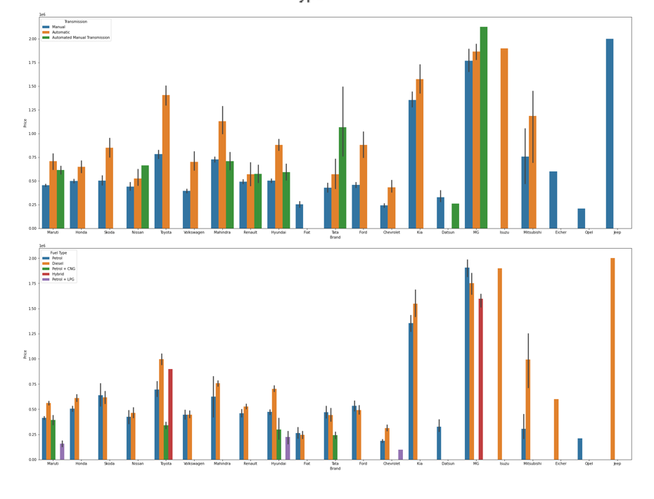

Slide 37
Following Observations are made from graphs above:
SUV and MUV cars with Automatic Transmission are the costliest
Hybrid Cars with Manual Transmission have the highest price followed by Diesel and Petrol cars with Automatic Transmission
Hybrid Type Hatchback and SUV Cars are the most expensive
Automatic Transmission Variants are the most expensive cars of most car brands
Diesel Variants,followed by Petrol Variants are the most expensive cars of most car brands

Slide 38
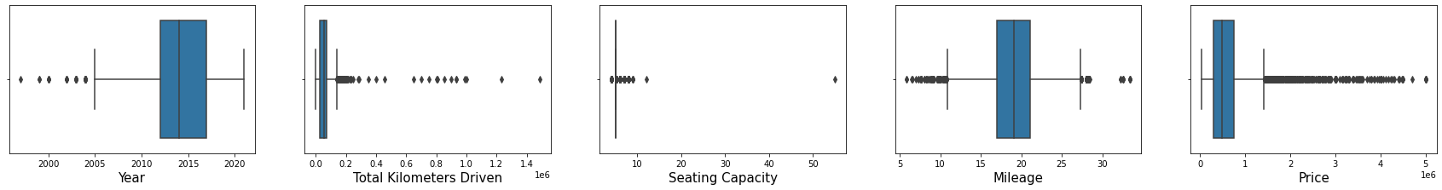
Checking for Outliers
There are considerable outliers in the columns.
Outliers were Removed using Z score method which resulted in a total data loss of 3.82%, which is within acceptable range.

Slide 39
Encoding Categorical Columns
Categorical Columns were encoded using Label Encoding technique and get_dummies() technique.

Slide 40
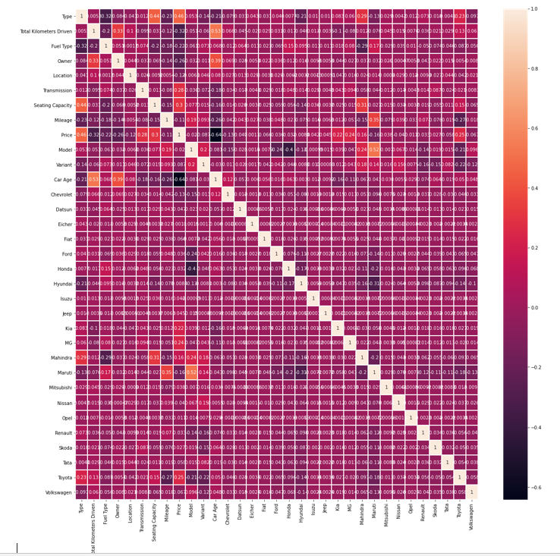
Finding Correlation between Feature and Target columns

Slide 41
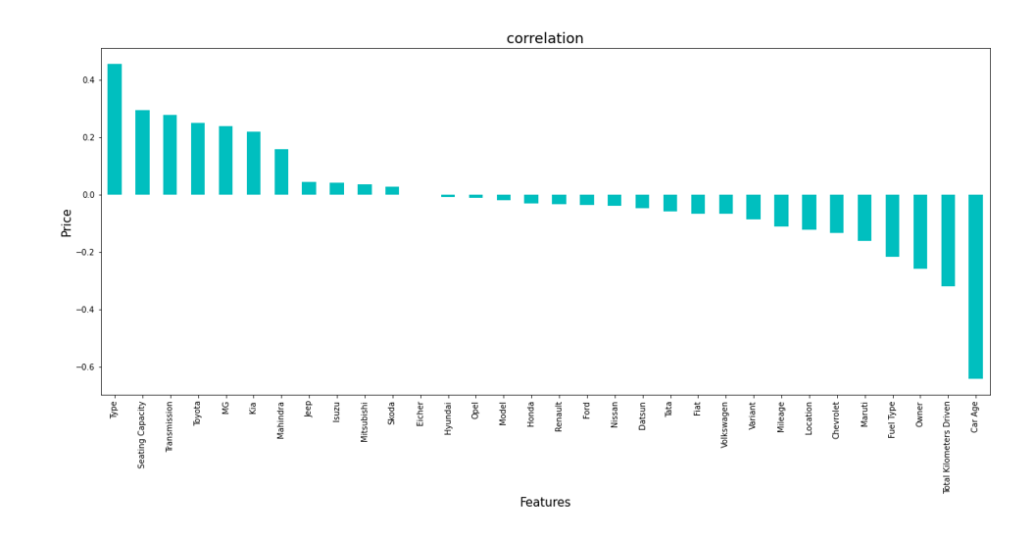
Type, Seating Capacity have the strongest positive correlation with Price while Car Age,Total Kilometers Driven,Owner and Fuel Type have the strongest negative correlation with Price.

Slide 42
Model/s Development and Evaluation
Feature Selection
Features were first checked for presence of multicollinearity and then based on respective ANOVA f-score values, the feature columns were selected that would best predict the Target variable, to train and test machine learning models.

Slide 43
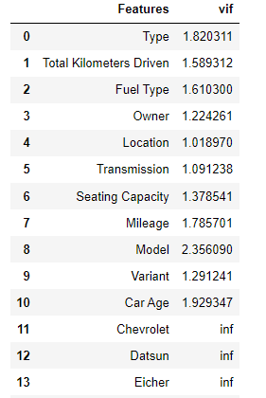
There is no Multicollinearity among the columns

Slide 44
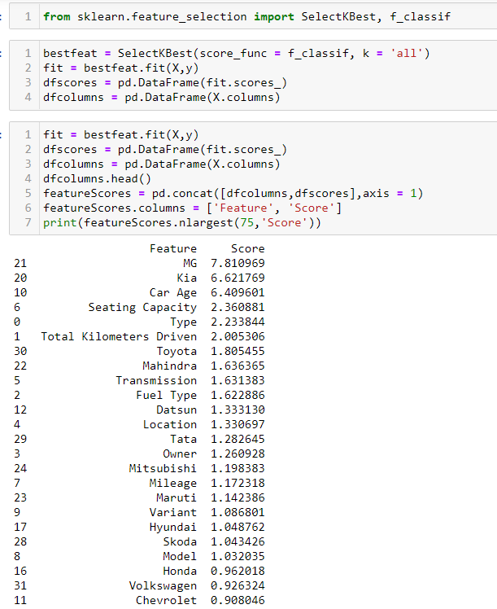

Slide 45
Using SelectKBest and f_classif for measuring the respective ANOVA f-score values of the columns, the best features were selected. Using StandardScaler, the features were scaled by resizing the distribution values so that mean of the observed values in each feature column is 0 and standard deviation is 1.
From sklearn.model_selection’s train_test_split, the data was divided into train and test data. Training data comprised 75% of total data where as test data comprised 25% based on the best random state that would result in best model accuracy.

Slide 46
The model algorithms used were as follows:
Ridge: Ridge regression is a model tuning method that is used to analyse any data that suffers from multicollinearity. This method performs L2 regularization. Since the features have multicollinearity occurs, least-squares are unbiased, and variances are large, this results in predicted values to be far away from the actual values. Ridge shrinks the parameters. Therefore, it is used to prevent multicollinearity.
DecisionTreeRegressor: Decision Tree solves the problem of machine learning by transforming the data into a tree representation. Each internal node of the tree representation denotes an attribute and each leaf node denotes a class label. A decision tree does not require normalization of data. A decision tree does not require normalization of data.

Slide 47
XGBRegressor: XGBoost uses decision trees as base learners; combining many weak learners to make a strong learner. As a result it is referred to as an ensemble learning method since it uses the output of many models in the final prediction. It uses the power of parallel processing,supports regularization, and works well in small to medium dataset.
RandomForestRegressor: A random forest is a meta estimator that fits a number of classifying decision trees on various sub-samples of the dataset and uses averaging to improve the predictive accuracy and control over-fitting. A random forest produces good predictions that can be understood easily. It reduces overfitting and can handle large datasets efficiently. The random forest algorithm provides a higher level of accuracy in predicting outcomes over the decision tree algorithm.

Slide 48
Support Vector Regressor: SVR works on the principle of SVM with few minor differences. Given data points, it tries to find the curve. But since it is a regression algorithm instead of using the curve as a decision boundary it uses the curve to find the match between the vector and position of the curve. Support Vectors helps in determining the closest match between the data points and the function which is used to represent them. SVR is robust to the outliers. SVR performs lower computation compared to other regression techniques.
K-Nearest Neighbor Regressor: It is a lazy learning, non-parametric algorithm. It uses data with several classes to predict the classification of the new sample point. KNN is non-parametric since it doesn’t make any assumptions on the data being studied. The Training phase is fast. KNN Regressor keeps all training data since they are needed during testing phase. KNN algorithm fairs across all parameters of considerations. But mostly, it is used due to its ease of interpretation and low calculation time.

Slide 49
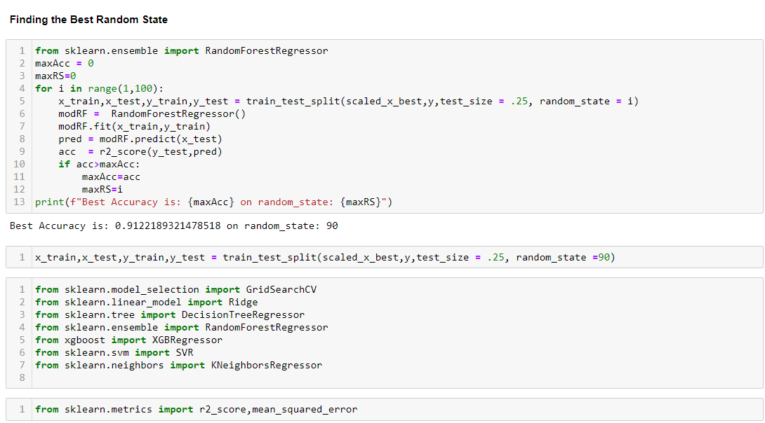
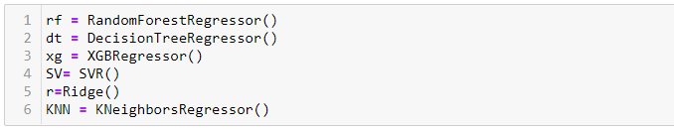
Regression Model Building

Slide 50
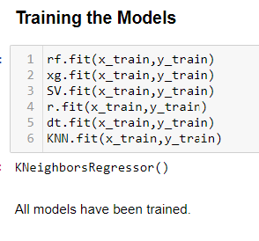

Slide 51
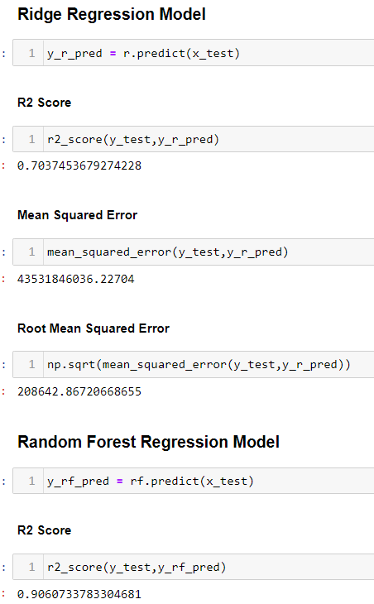
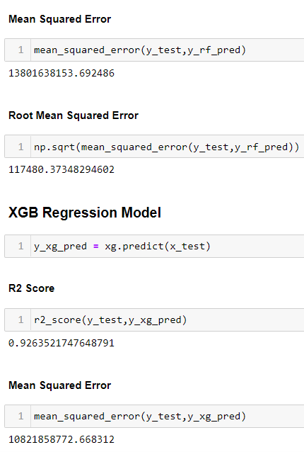
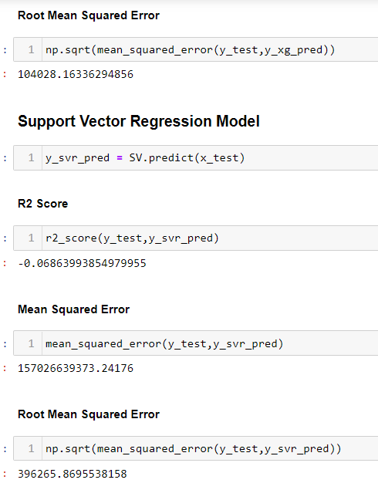

Slide 52
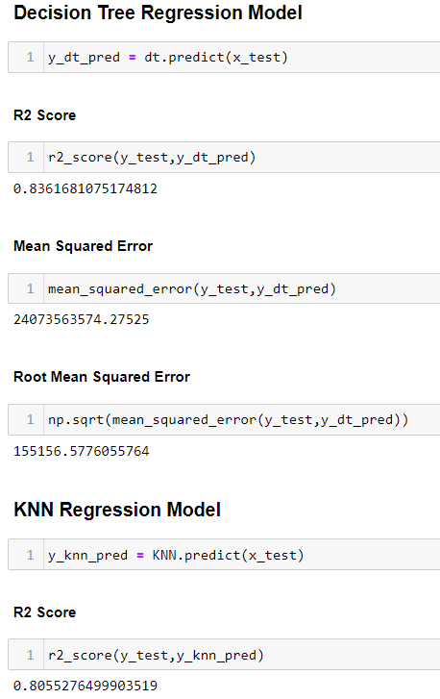
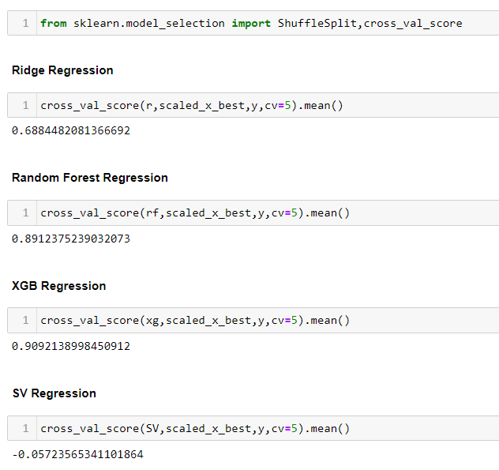
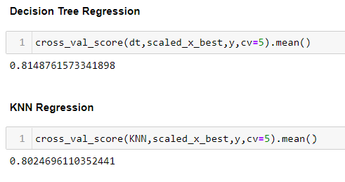
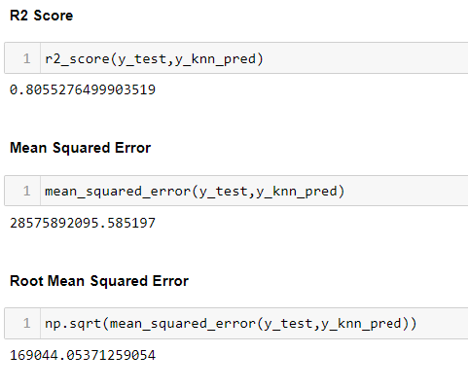

Slide 53
Analyzing Accuracy of The Models
Mean Squared Error and Root Mean Squared Error metrics were used to evaluate the Model performance. The advantage of MSE and RMSE being that it is easier to compute the gradient. As, we take square of the error, the effect of larger errors become more pronounced than smaller error, hence the model can now focus more on the larger errors.
Cross validation is a technique for assessing how the statistical analysis generalises to an independent data set.It is a technique for evaluating machine learning models by training several models on subsets of the available input data and evaluating them on the complementary subset of the data.

Slide 54
Using cross-validation, there are high chances that we can detect over-fitting with ease. Model Cross Validation scores were then obtained for assessing how the statistical analysis generalises to an independent data set. The models were evaluated by training several models on subsets of the available input data and evaluating them on the complementary subset of the data.
Interpretation of the Results
Based on comparing Accuracy Score results with Cross Validation results, it is determined that XGB Regressor is the best model. It also has the lowest Root Mean Squared Error score.

Slide 55
Hyper Parameter Tuning
GridSearchCV was used for Hyper Parameter Tuning of the XGB Regressor model.

Slide 56
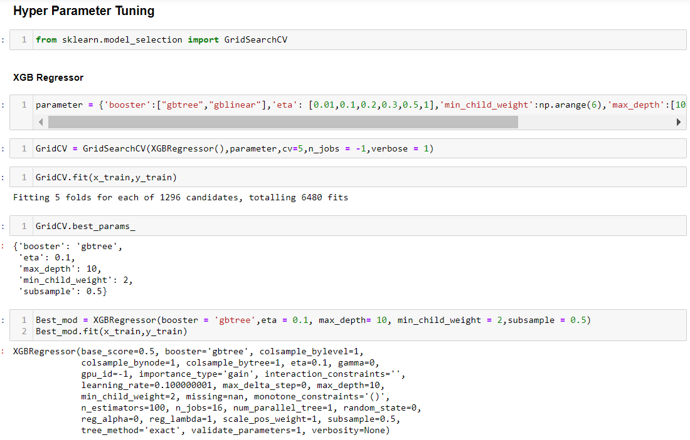
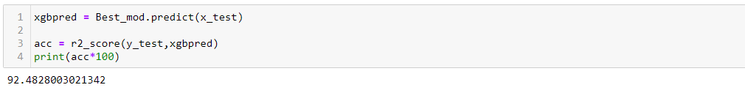

Slide 57
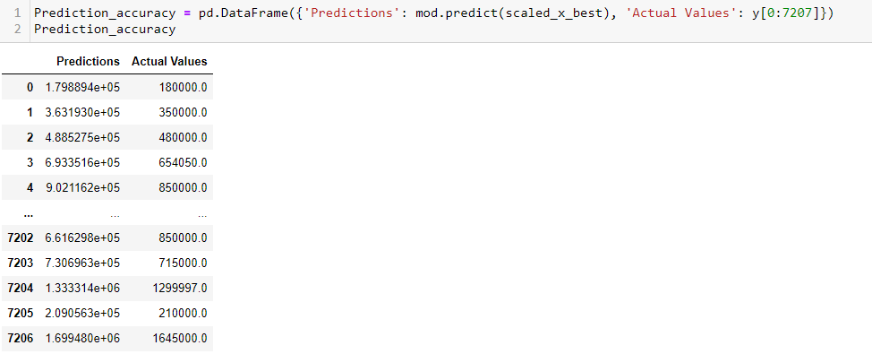
Based on the input parameter values and after fitting the train datasets The XGB Regressor model was further tuned based on the parameter values yielded from GridsearchCV. The Random Forest Regressor model displayed an accuracy of 92.48%
This model was then tested using a scaled Test Dataset comprising of 7207 entries. The model performed with good amount of accuracy.

Slide 58
In summary, Based on the visualizations of the feature-column relationships, it is determined that, Features like Type, Seating Capacity have the strongest positive correlation with Price while Car Age,Total Kilometers Driven,Owner and Fuel Type have the strongest negative correlation with Price. and are some of the most important features to predict the label values. XGB Regressor Performed the best out of all the models that were tested. It also worked well with the outlier handling.

Slide 59
CONCLUSION
Key Findings and Conclusions of the Study and Learning
Outcomes with respect to Data Science
Based on the in-depth analysis of the Housing Project, The
Exploratory analysis of the datasets, and the analysis of the Outputs
of the models the following observations are made:
Car attributes like Type,Car Age, Seating Capacity,Total Kilometers Driven,Transmission,Fuel Type,Owner and Mileage etc play a big role in influencing the used car price.
Brand Name also has a very important role in determining the used car price.
Various plots like Barplots,Countplots and Lineplots helped in visualising the Feature-label relationships which corroborated the importance of Car features and attributes for estimating Sale Prices.
Due to the Training dataset being very small, the outliers had to be retained for proper training of the models.
Therefore, XGB Regressor, which uses the power of parallel processing,supports regularization, and works well in small to medium dataset performed well despite having to work on small dataset.

Slide 60
CONCLUSION
Learning Outcomes of the Study in respect of Data Science
Data cleaning was a very important step in removing plenty of anomalous data from the huge dataset that was provided.
Visualising data helped identify outliers and the relationships between target and feature columns as well as analysing the strength of correlation that exists between them.
Limitations of this work and Scope for Future Work
A small dataset to posed a challenge in building highly accurate models. The presence of anomalous entries in the numbers heavily distorted the data distributions and may have had some impact on model learning. Availability of more features would help build better models.

